Slide 1
Final PROs
Information Extraction [Frank, Peter and Jana]
Autonomous-smart control and experimentation
[Subramanian, Xiaobiao and Kevin]
FAIR scientific data for ML-driven discovery [Alex, Mathieu, Dani]
Digital Twins: Artificial laboratories for scientific discovery
[Rama, Mariam]
Notes:
Presented during second panel presentation

Slide 2
PRO 1 Information Extraction
Scientific challenges
Summary of research direction
AI analysis of large and/or high-dimensional data along with AI Guided Simulation Models
On-the-fly information extraction to drive realtime responses
Accelerate Scientific Knowledge from large data sets
Write information not data
Develop fast/scalable AI/ML methods to address the scientific challenges
Incorporate domain-specific knowledge
ML/AI Challenges
Potential impact
ML not easily adapted to current and emerging heterogeneous hardware
Verification and validation of data reduction models
Methods fast enough for on-the-fly information extraction
Science inputs to and outputs from ML models
Connect and leverage the whole portfolio of facility scientific data
Increase science output from and coupling between BES facilities
Faster time to materials characterization and understanding
Address higher levels of complexity in materials
‹#›
Notes:
Presented during second panel presentation

Slide 3
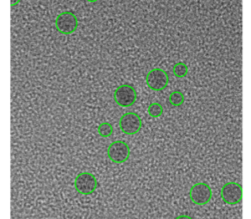

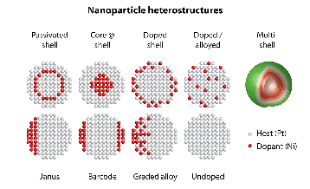
Same tools, New laboratory
Navigate complexity with AI
Today, we are swamped with large volumes of disparate data. Measurements are hard to connect, and contain complex, high-dimensional information
AI to the rescue
ensemble measurement
Immediately observe individual participants
In the short term, it’s the same tools
Longer term, this will drive the new tools
Understand underlying physics of system
New discoveries – previously hidden by complexity
Notes:
Photoluminescent CdSe nanoparticles – robotically produced. Want to optimized based on ensemble measurement.
TEM shows you that there is population heterogeneity.
If you can quickly scan / understand the heterogeneity, much quicker to
Optimize the approach
Understand underlying physics
2 years: classify heterogeneity
5 years: deconvolve heterogeneity
10 years: engineer the heterogeneity to do what you want (e.g. self-healing alloys, multi-functional catalysis)

Slide 4
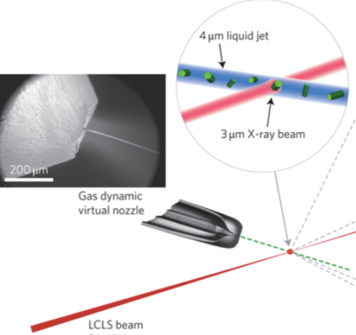
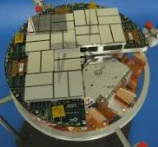
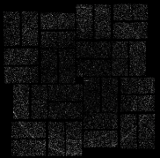
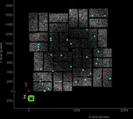
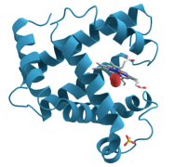
Science in real time
Record knowledge at the rate of measurement
Today
seconds
hours
months
Multi-megapixel detector
X-ray diffraction
image
Intensity map from multiple pulses
Interpretation of system structure / dynamics
60 GB/s
6 GB/s
1 TB/s
100 GB/s
Tomorrow
seconds
Circumventing complex manual analysis
What takes months today – will take seconds
Notes:
2 years: ms 🡪 us
5 years: indexing (physical interpretation) – from hours to seconds
10 years: direct writing of structures / approaching system level understanding

Slide 5
PRO 2 Autonomous-smart control and experimentation
Scientific challenges
Summary of research direction
Modern material and chemical phase space are large & complex; how to find interesting anomalies?
Tuning for high-dimensional, nonlinear, coupled parameter space with drifting latent variables.
Fault and anomaly detection and prediction to reduce down time.
Build predictive, fast, cheap and transferable models for prognostics, data augmentation, decision making and feedback
Explore and develop model-based methods for efficient optimization and control
ML/AI Challenges
Potential impact
Develop AI/ML for science: decision trees (e.g. MCTS) with reinforcement learning, Bayesian optimization, active learning, etc.
Physics-aware/informed/constrained ML (dimension reduction, interpretable models, and physics extraction)
Lack of data to train ML/AI models
Efficient experimental searches, enabling discovery of novel functional materials, especially non-equilibrium and metastable states.
Fully autonomous operation of experimental facilities, maximizing efficiency, scalability, reproducibility and stability.
‹#›
Notes:
Presented during second panel presentation

Slide 6


Monitoring the Heartbeat of an Accelerator
How?
Operation of accelerators relies on keeping thousands of system components running optimally. With AI, we can teach accelerators to monitor and optimize their own health and performance.
Achieving 95% reliability at the Spallation Neutron Source accelerator

Slide 7

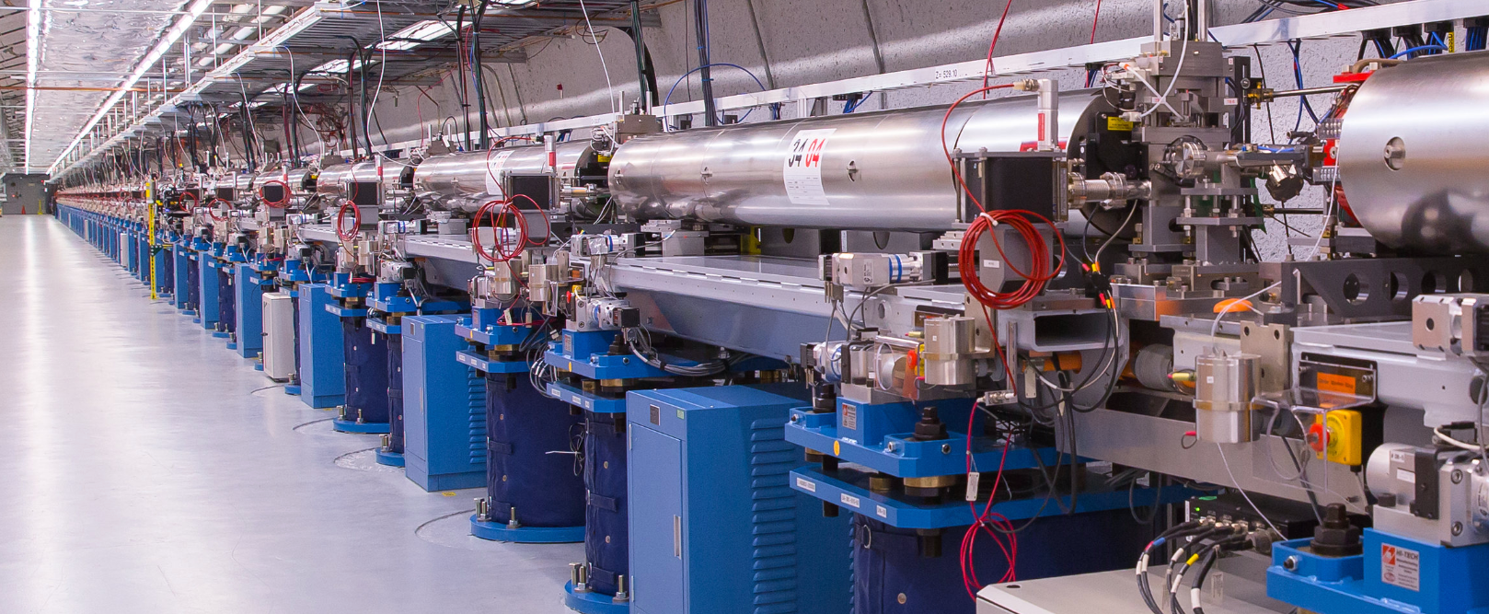
Maximizing the Value of DOEs largest scientific facilities with AI
Accelerators rely on operation and high precision tuning of hundreds of thousands of parameters simultaneously.
We can use AI to create self-driving, high-performance accelerators.
Customizable shot by shot configurations for xFEL experiments
Reducing time to configure experiments from one day to one minute
Orders of magnitude improvement of source to detector stability

Slide 8
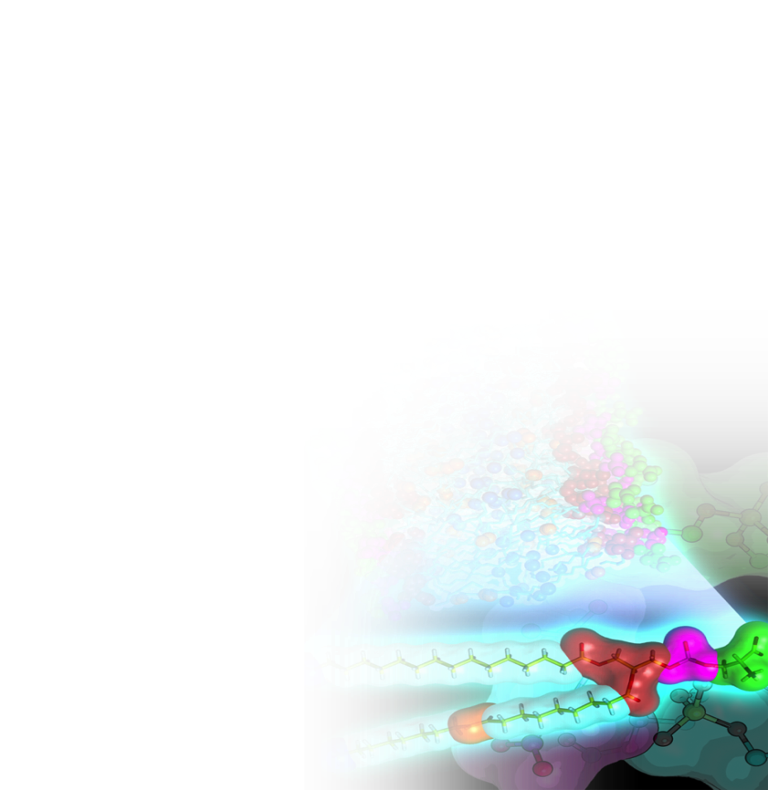
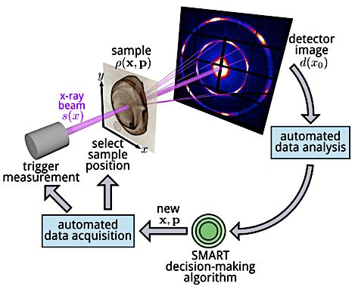
Transformative advances are possible
On-the-fly materials & chemical synthesis
How? Use autonomous-smart experiments and simulations enabled by AI
requires a new class of machine learning algorithms that continually learn and update their predictions based on new data sources, encode physical constraints/laws and models, and learn to estimate fidelity
Delivering materials/chemicals ~1000x faster and with desired performance/properties
Notes:
AI (true sense, not machine learning; need continuous learning so as to allow updating predictions based on new data sources from an array of instruments, encoding physical constraints/laws and models, and learning to estimate fidelity) to enable on-the-fly materials/chemical synthesis, e.g., not identifying a materials/chemical but actually making that material/chemical that delivers pre-defined performance and properties. A true grand challenge but it is a game changer and is a positive disruption in our traditional approach of make/synthesize, characterize, understand via theory/simulation and then after years, integrate back to refine. It potentially could be more than 1000X faster!

Slide 9
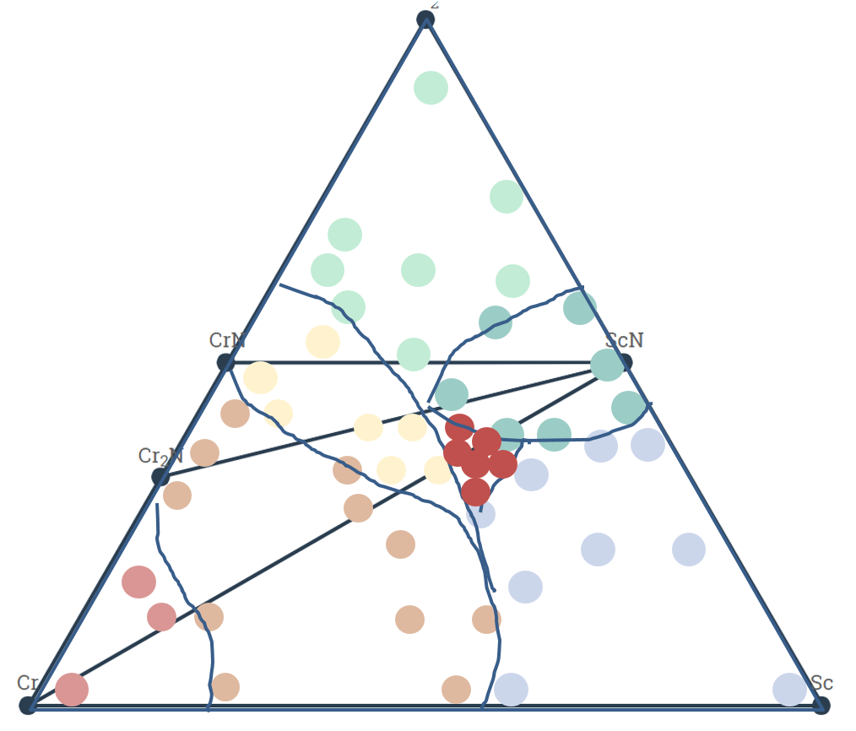
Complex materials at work
Real materials are compositionally complex
More possible materials than could be explored in 100 lifetimes
Autonomous science will be able to explore enormous spaces, and find the “needles in the haystack”
Impact: Revolutionary energy materials
Batteries 10X faster charging; 1/10th cost
Catalysts for liquid fuels

Slide 10
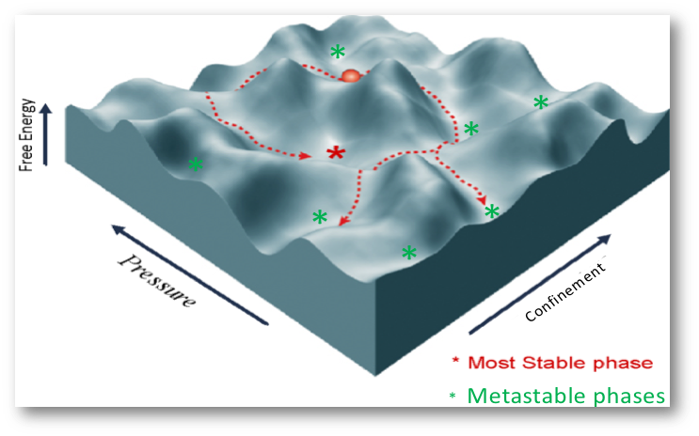
Steered Synthesis
Typical materials are the “stable” ones that are easy to make
But there are ultra-high-performance materials that could be made if only we could guide synthesis in real time into these metastable states
Impact: “Steel of the future”: Metallic glasses for high-strength and corrosion resistant materials (turbine blades)

Slide 11
PRO 3 Shared Scientific Data for Machine Learning Driven Discovery
Scientific challenges
Summary of research direction
- Radically improve data curation for scientific discovery and comparison of complex materials and processes across facilities.
- Enable far greater use and reuse of scientific data and algorithms.
- Provide natural language and domain-specific searches for scientific data across domains.
- Create a catalog of linked data, metadata, analysis workflows and results that can be searched, studied, and discovered across facilities.
- Develop open & interoperable access patterns for facilities. - Automated tagging of scientific data.
ML/AI Challenges
Potential impact
- Accelerate discovery with access of vast amount of diverse, comprehensive data.
- Access to diverse data to aid the development of new algorithms and machine learning approaches.
- Automate creation of new links between experiments, models and analysis to optimize scientific facilities.
Automatic development of training sets from heterogeneous data
Use AI to mine schemas and user publications to capture ontology across facilities
‹#›
Notes:
Brainstorming
Accelerate discovery with access of vast amount of diverse, comprehensive data and results - Optimize use of the nation’s scientific user facilities
identify patterns across experiments
- Access to diverse data to aid the development of new algorithms and machine learning approaches.
- Automate creation of new links between experiments, models and analysis.
Automatic development of training sets from heterogeneous data
Develop infrastructure to build, test and deploy new and emerging AI and ML algorithms.
- Build reference dataset for verification, development and benchmarking.
- Scientific language to search for data-learned descriptors.
- Compare and validate new data or algorithms against existing ones.
Ontology for everything
Develop infrastructure to allow ML/AI access to SUF data & results

Slide 12
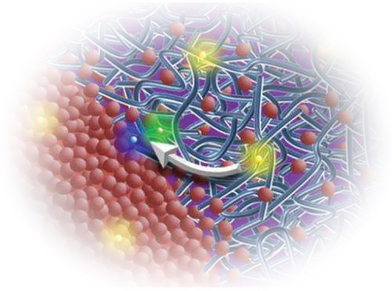
Intelligent Scientific Knowledge Search across Facilities
A national knowledge repository, enabled by AI/ML, will leverage the yearly work of 16,000 scientific users at SUFs to accelerate discoveries.
Easy to use search across all the data will unearth new research targets and ideas.
How to find a pathway to double Organic Photovoltaic performance?
1,000,000’s of measurements
1000’s of papers per year
terabytes of data
no common search tool
no pattern extraction across data
no AI/ML tools to find higher performance OPV’s
Extracting knowledge in seconds from years of experimental data collected across user facilities
Notes:
no common search tool
no pattern extraction across data
AI can bring together all that we have learned to find the next experiments
AI can identify the next research targets by joining everything we have learned
Easy searching across?
unearth new research targets
unearth new ways -> unearth new results?
topics -> fields?
targets -> directions?
[the problem] Thousands of papers are produced every year on OPVs from experiments done in isolation.
[our solution] A curated data system for AI/ML will enable scientists to leverage that wealth of information to accelerate discoveries.
How to double the efficiency of Organic Photovoltaic?
Only ML & AI will harvest the work of 16,000 users of SUFs
From millions of measurements, Thousands of papers are produced every year on OPVs from experiments done in isolation.
No human
100s of thousands of individual experiments per facility. Humanly not possible to extract the necessary knowledge to double efficiency in a realistic timeframe.
Radically improve data curation for scientific discovery and comparison of complex materials and processes across facilities.
- Enable far greater use and reuse of scientific data and algorithms.
- Provide natural language and domain-specific searches for scientific data across domains.
Use AI to mine schemas and user publications to capture ontology across facilities
Optimize use of the nation’s scientific user facilities
- Accelerate discovery with access of vast amount of diverse, comprehensive data.
- Access to diverse data to aid the development of new algorithms and machine learning approaches.
- Automate creation of new links between experiments, models and analysis.

Slide 13
PRO 4
Digital Twins: Virtual Laboratories for Scientific Discovery
Scientific challenges
Summary of research direction
Synthesis routes to new materials
Matching theory with experiment
Accurate, fast predictions from physical models
Sub-optimal experimental designs
Design and prepare experiment without facility access
Creating a reproducible simulation environment of experiment facilities from conception to synthesis to characterization.
Automated design of optimal experiment(s) and analysis for physics knowledge acquisition
ML/AI Challenges
Potential impact
Rapid simulations and surrogate models
Frameworks for merging multidimensional data with physical models
Online, adaptive machine learning
Physics model calibration with ML methods
Inverse problems of measurement to physical descriptors
Accelerated scientific discoveries with targeted data collection and analysis
Improved facility and workflow design
Increase experiment knowledge gain
Context-based experiment planning
Enable new type of experimental paradigms
‹#›
Notes:
Presented during second panel presentation
Defined learning goals
Engaging 360 animations
Interactive experiments with simulated data

Slide 14
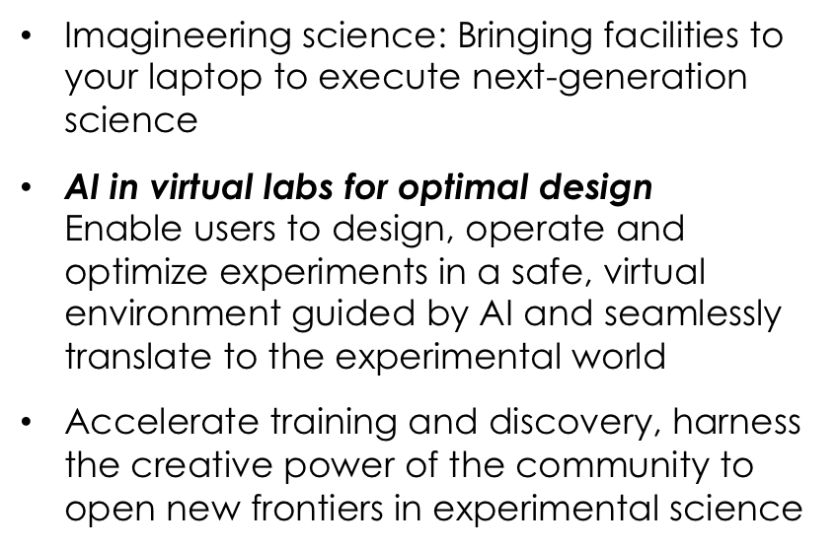
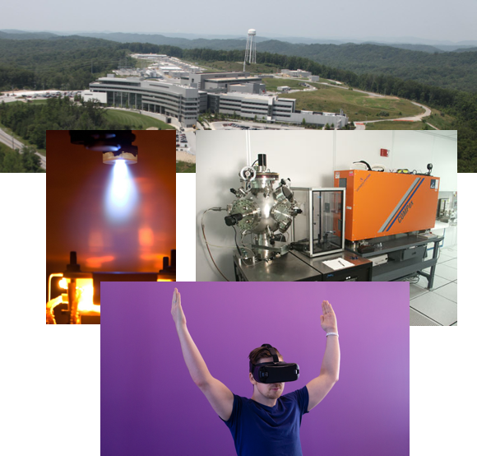
Virtual Laboratories in a Real World: Enabling Moonshots
Unifies, democratizes and augments scientific user facilities

Slide 15
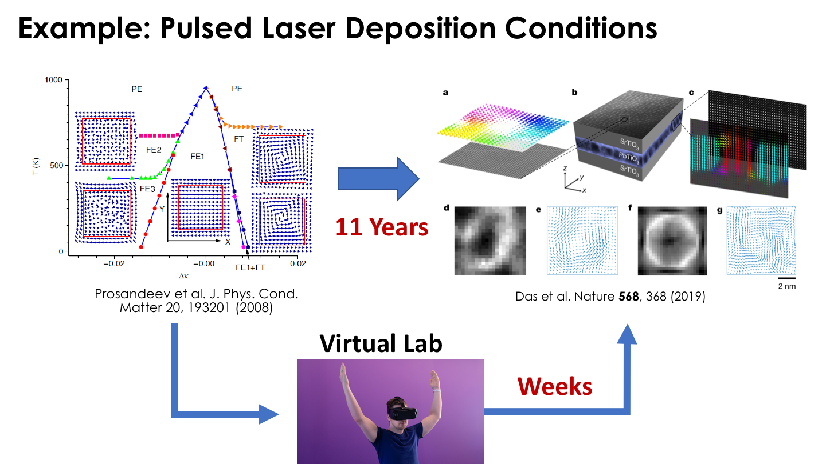
Accelerating Materials Synthesis
Accelerate the cycle from prediction to realization

Slide 16
PRO 5 Enter name of 1st priority research opportunity (PRO) here
Scientific challenges
Summary of research direction
Brief overview of the underlying science challenge
What will you do to address the challenge?
Why can this research be done now? (e.g. new understanding or capability)
Please use this slide for each priority research direction (PRO). Additional slides may be used to expand on the PRO
ML/AI Challenges
Potential impact
What ML/AI methods will be used?
What ML/AI research is still needed?
What data/ML infrastructure is needed (training sets, worfklows, etc.)
What new scientific discoveries will follow?
What new methods and techniques will be developed?
How will this impact industry?
‹#›
Notes:
Presented during second panel presentation

Slide 17
PRO x. Title Back-up
Suggested slides for potential sidebars
Images with captions (and credits) that may be used in the report
References

